Slide 1
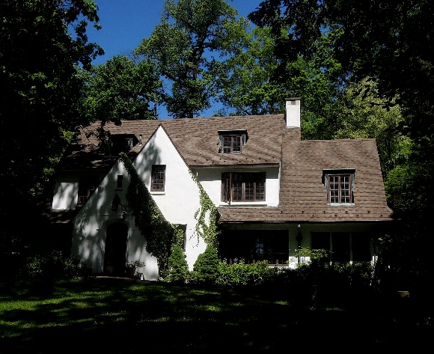
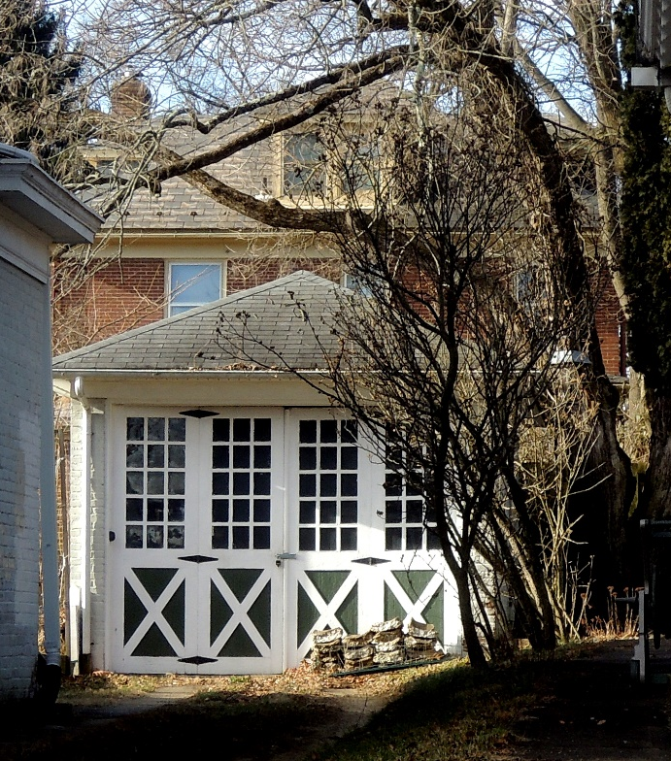
“There may have been a time when preservation was about saving an old building here and there, but those days are gone. Preservation is the business of saving communities and the values they embody.”
Richard Moe
National Trust for Historic Preservation

Slide 2
Creating a
College Hill Conservation District
A Neighborhood Discussion
June 27, 2019

Slide 3
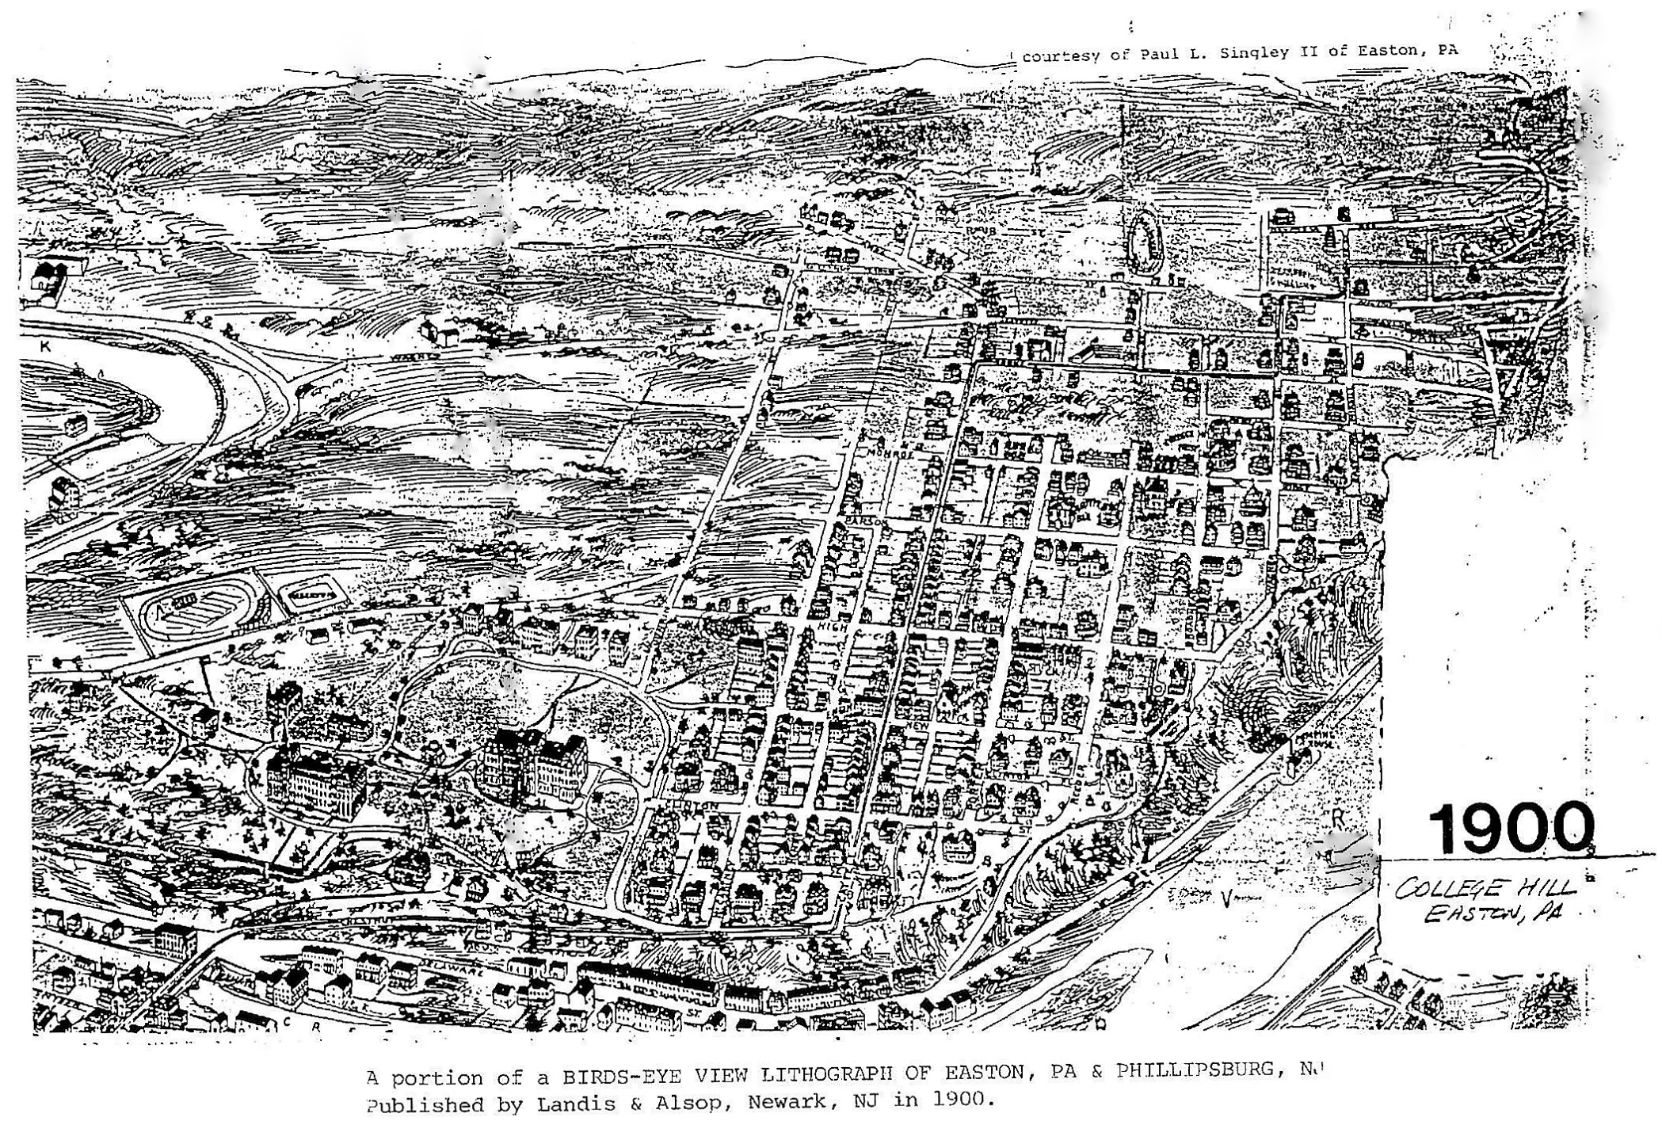
What does it mean to be a neighborhood
and a community in our city?
College Hill in 1900

Slide 4
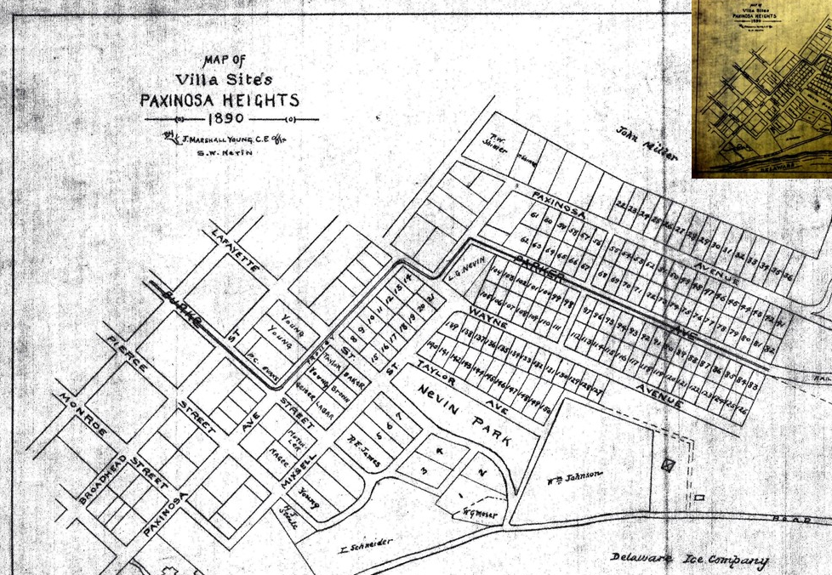
College Hill developed as a carefully planned series of neighborhoods consisting primarily of single family homes.
The neighborhood has always been a walkable urban area with well constructed buildings in a variety of architectural styles.

Slide 5
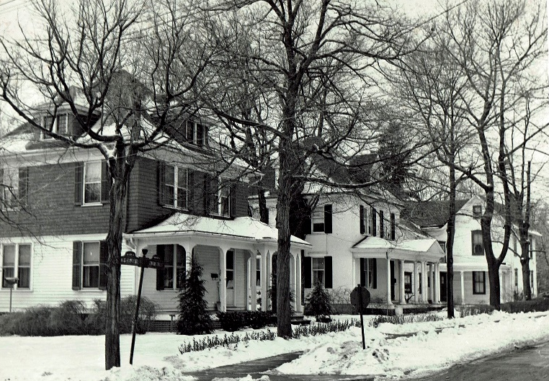
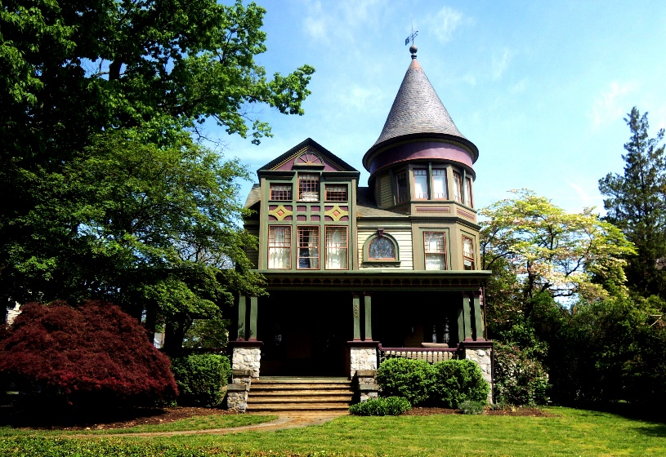
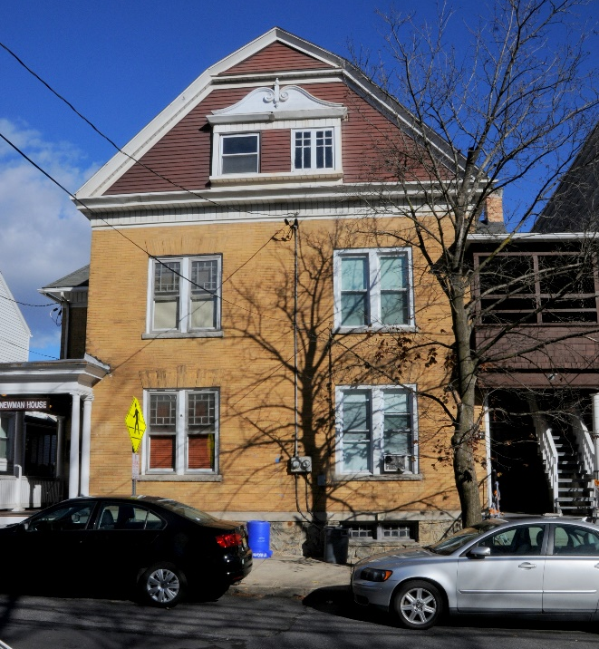
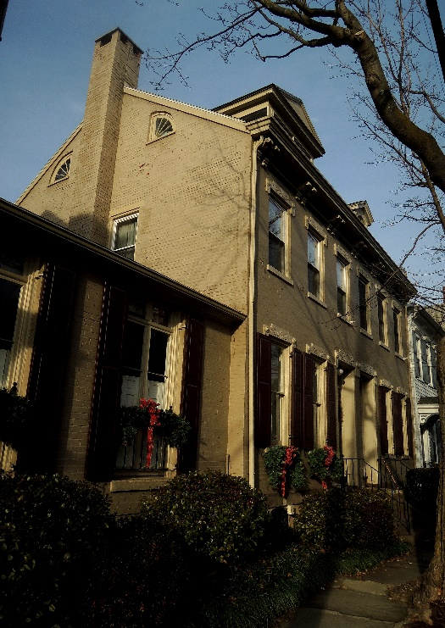
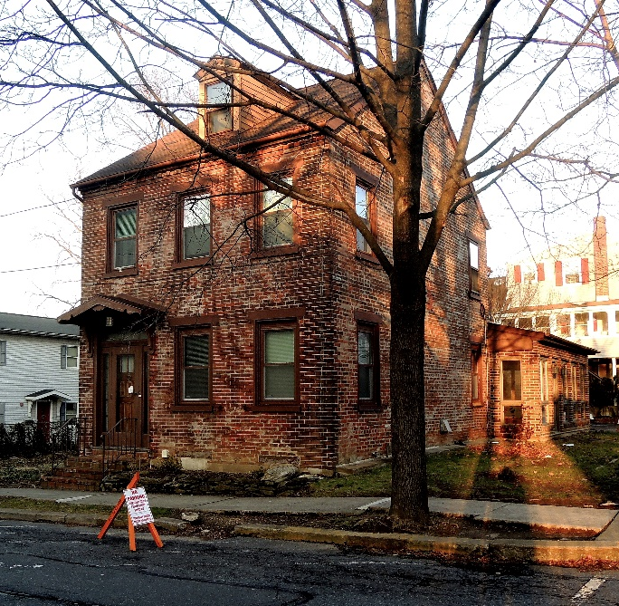
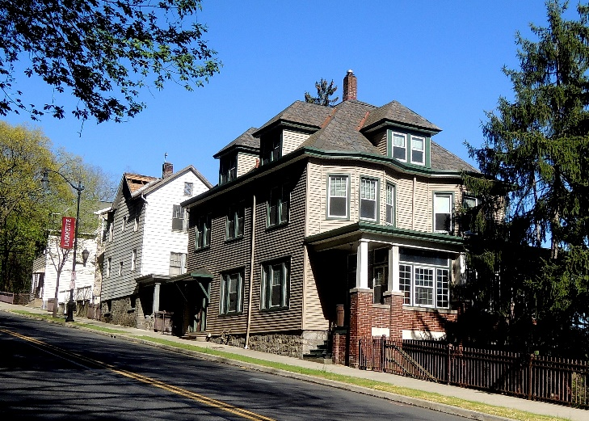
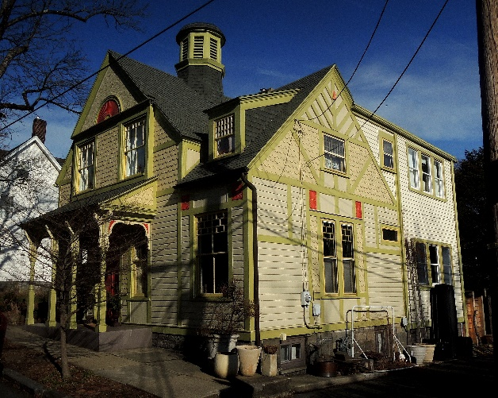
Most of College Hill (except the Lafayette College campus) is part of the College Hill National Residential Historic District.
More than 64% of Easton’s total housing stock was built before 1939. College Hill’s percentage is even higher than that.

Slide 6
Older homes give a neighborhood its character and provide most of its affordable housing* stock.
* Many people think that “affordable housing” refers only to housing for people of low income. That can be part of it, but a more accurate understanding is that neighborhoods should provide a range of housing options for residents with a variety of incomes and housing needs. From wealthier families to downsizing retirees, from business owners to students, from property owners to renters, College Hill has always done that.

Slide 7
“Cities need old buildings so badly it is probably impossible for vigorous streets and districts to grow without them.”
Jane Jacobs
Being part of a National Residential Historic District does not protect a building from demolition. Over the years, many homes have been demolished on College Hill.

Slide 8
In the near future, many more homes are expected to be demolished.

Slide 9
Currently, Easton has no laws to prevent buildings from being demolished, no matter how beautiful or historic they are and no matter how much they contribute to the character, vitality and diversity of their neighborhood.
The incremental removal of housing stock has caused both a decline in the quality of life on College Hill and a loss of affordable housing.
“We are only the trustees for those who come after us.”
William Morris

