Slide 1
2019
1900 - 2018

Slide 2
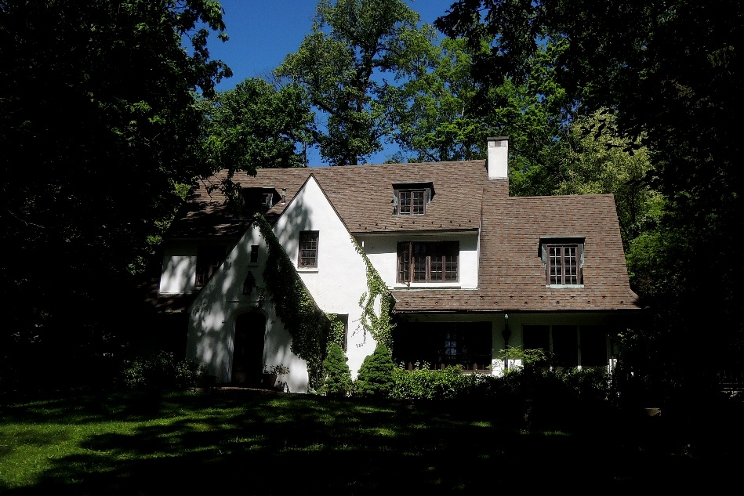
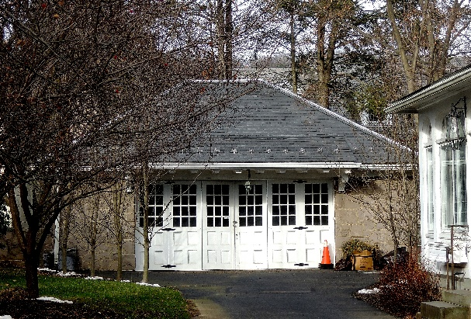
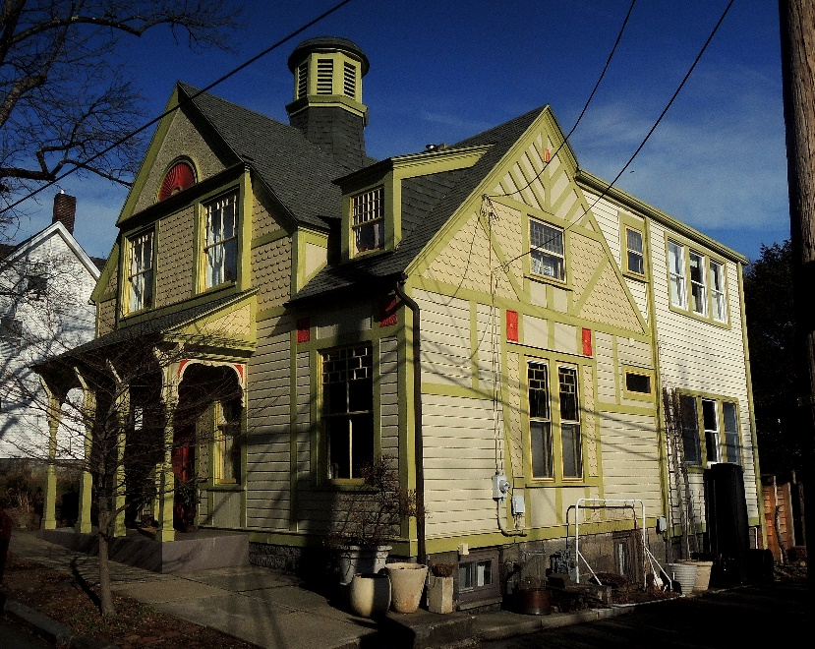
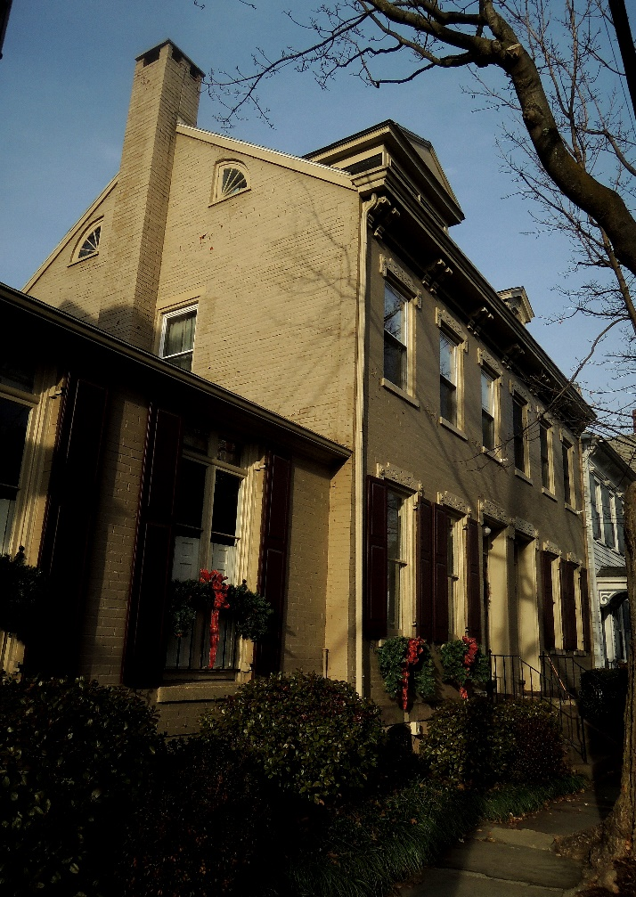
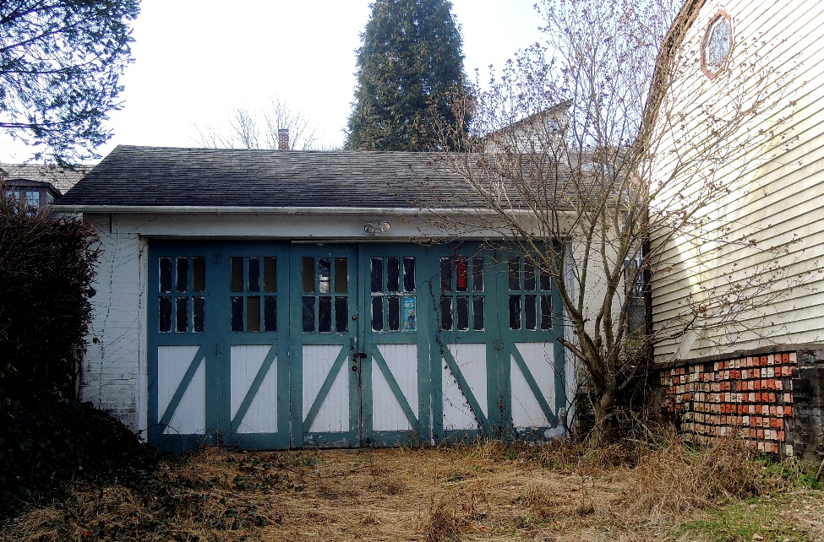
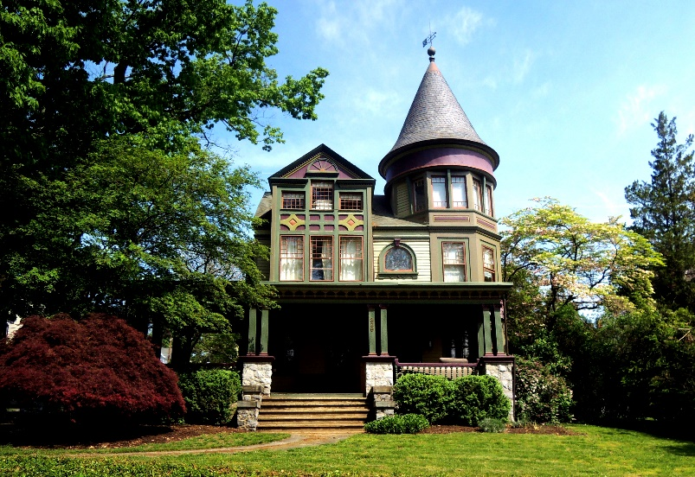
Conservation Districts can provide a means for preserving the physical character of our neighborhoods, but they can do much more.
Conservation Districts do not replace or supersede zoning ordinances. They are complimentary to them.

Slide 3
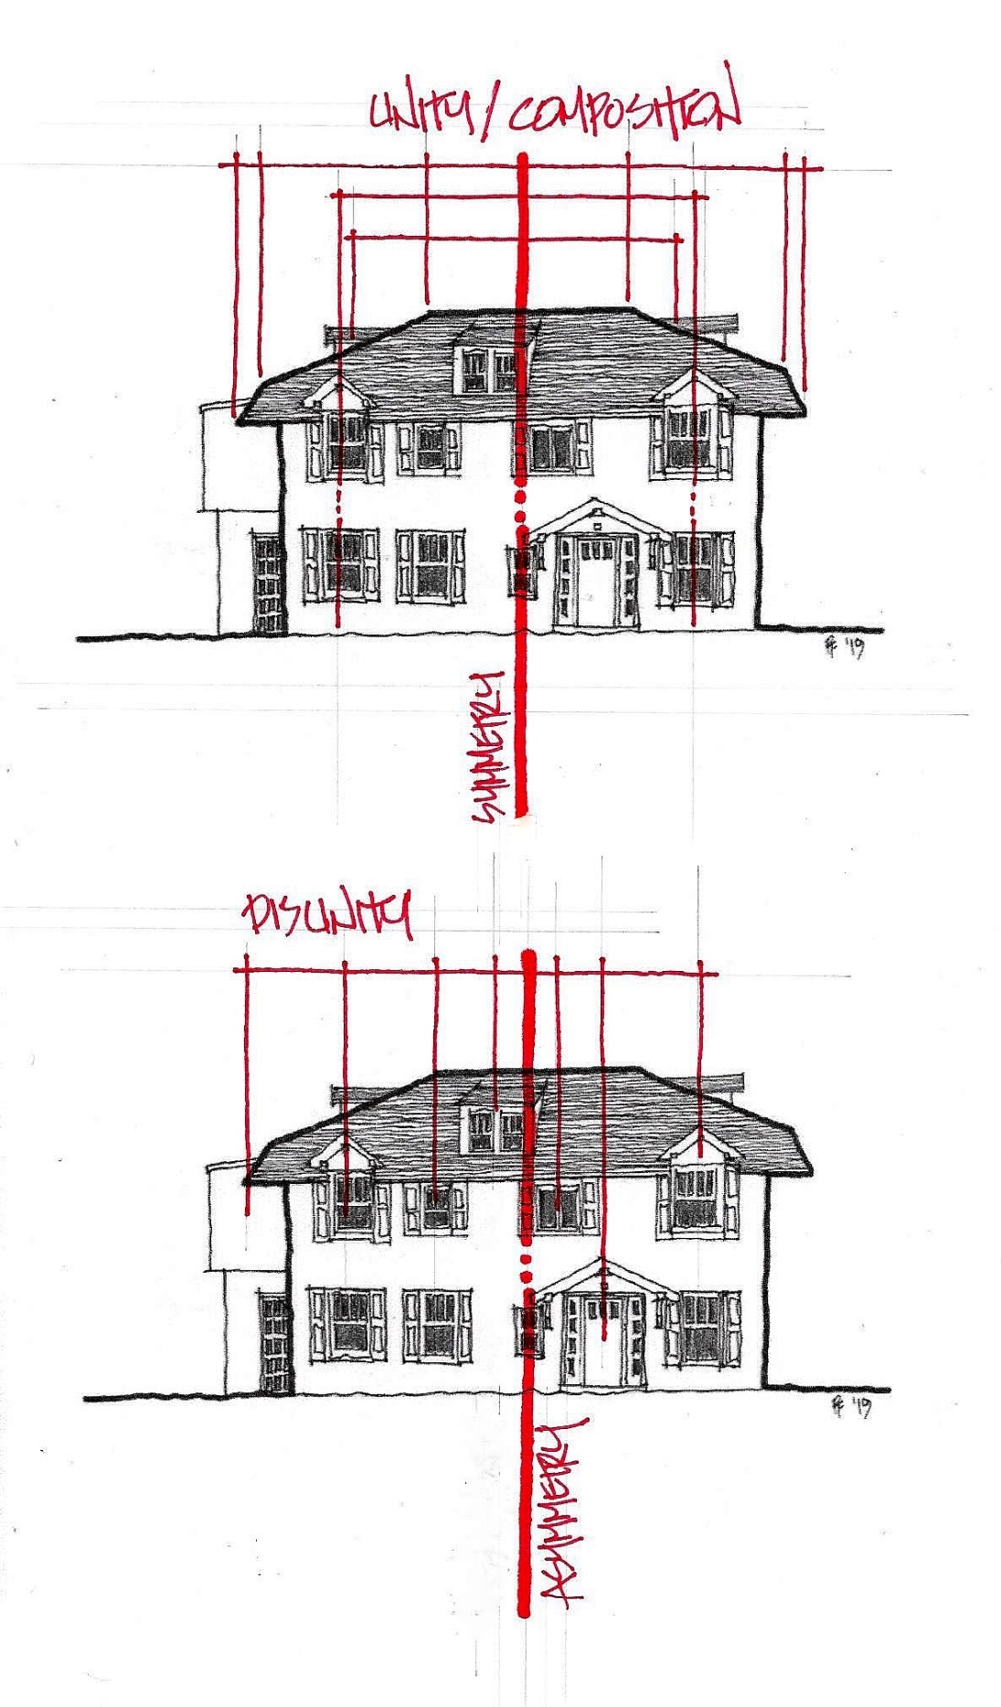
Dozens of Pennsylvania cities have Conservation Districts, but there are none in Easton. Easton’s downtown National Register Historic District helps protect most buildings from demolition and in many other ways.
Conservation Districts are controlled at the municipal level, can be based on neighborhood values, and can be custom-tailored within and between neighborhoods.

Slide 4
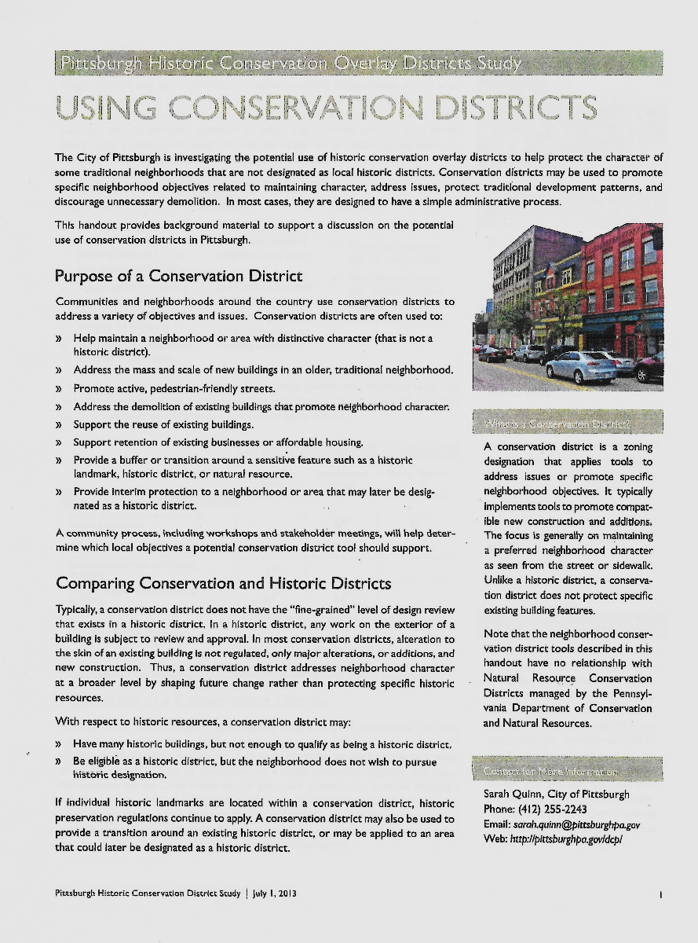
Pittsburgh has done an excellent job studying the potential and defining the benefits of Conservation Districts

Slide 5
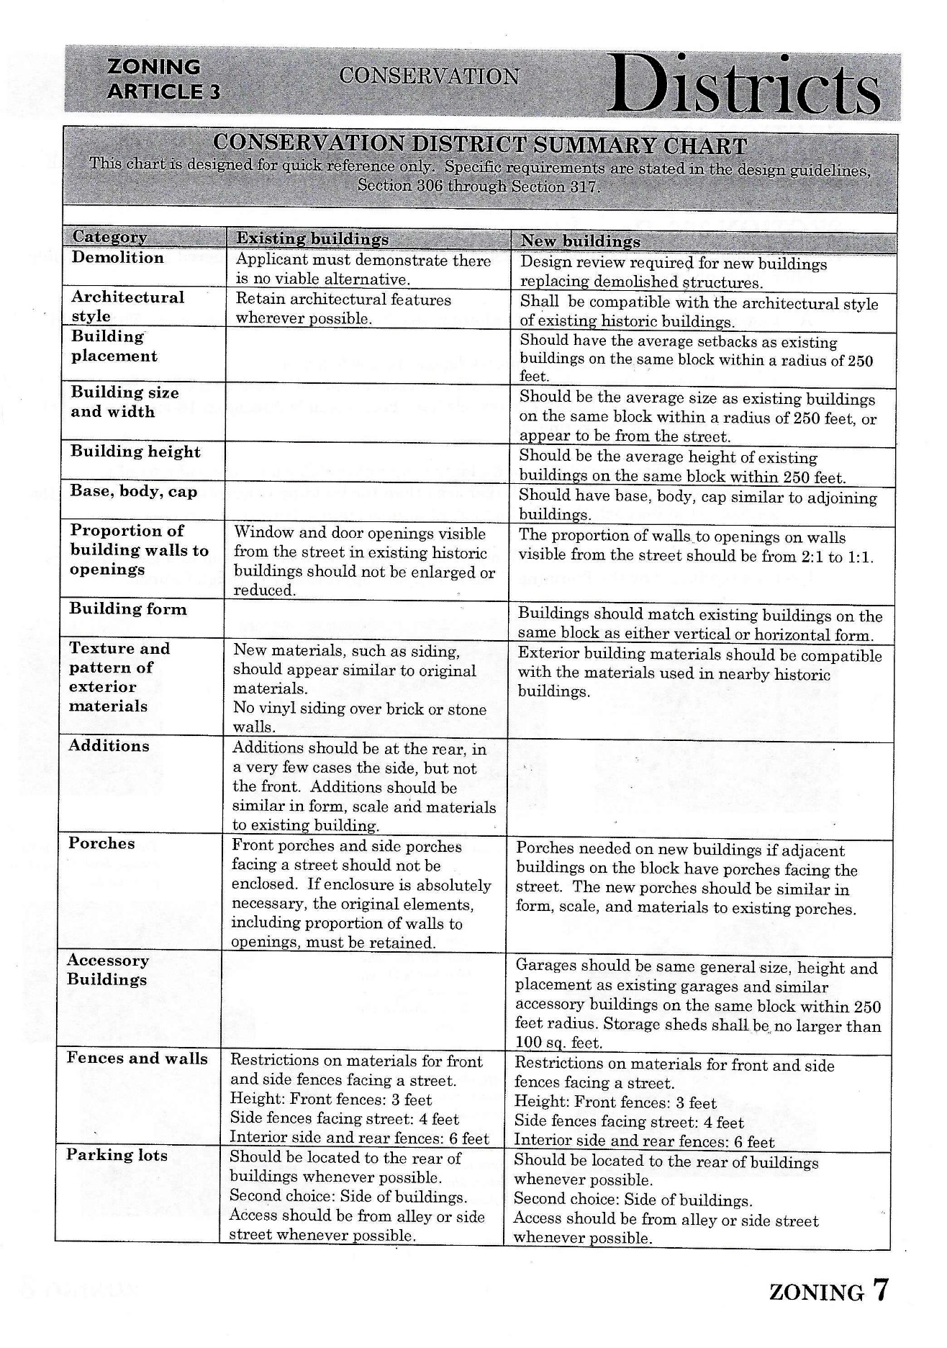
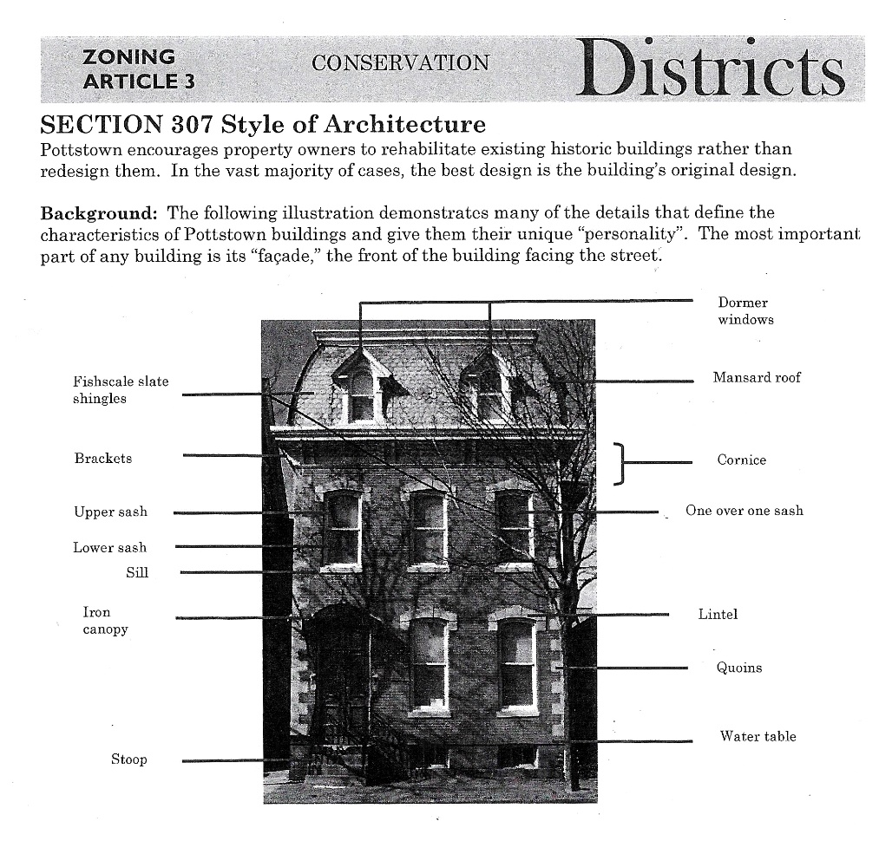
Conservation Districts can range in scope from very comprehensive to minimal. For example, Pottstown, PA has a comprehensive District that covers everything from demolition and architectural style to fences and walls.

Slide 6
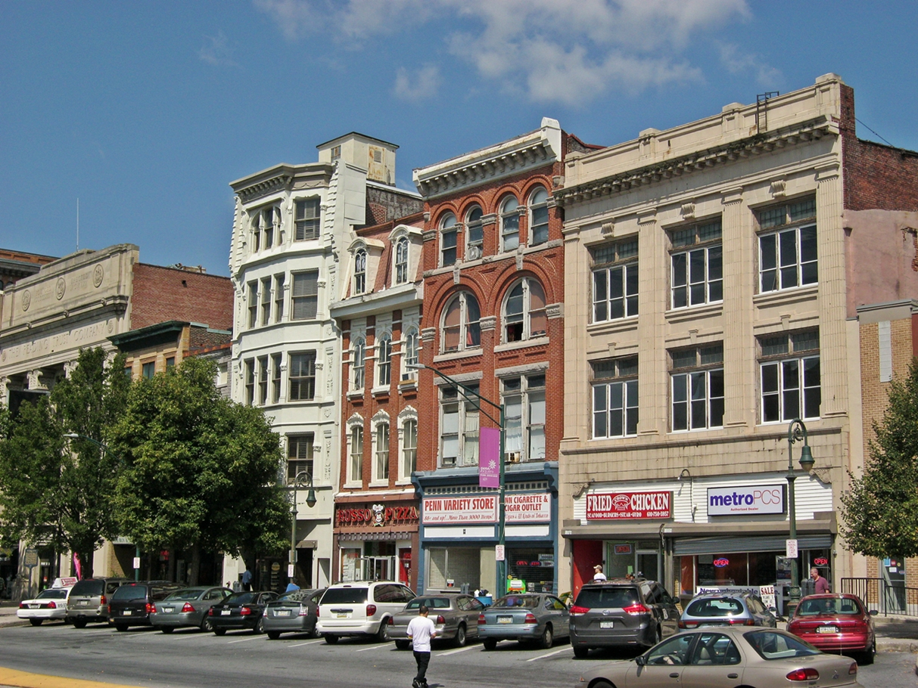
Reading, PA’s Conservation District is relatively simple. It regulates demolition, major additions and renovations, and porch enclosures.*
*Porch enclosures are a good example of the types of construction project that residents of some neighborhoods may feel need to be regulated, but are not much of an issue in other neighborhoods.

Slide 7
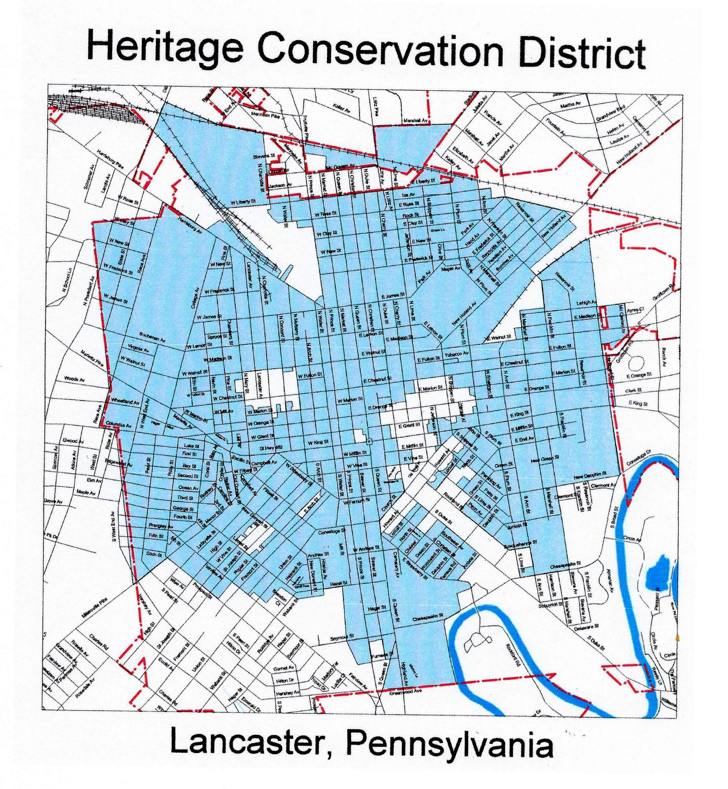
Lancaster has designated the majority of its older neighborhoods as Historic Conservation Districts in order to maintain their attractive historic character and to ensure that affordable housing is protected for the welfare of its citizens.

Slide 8
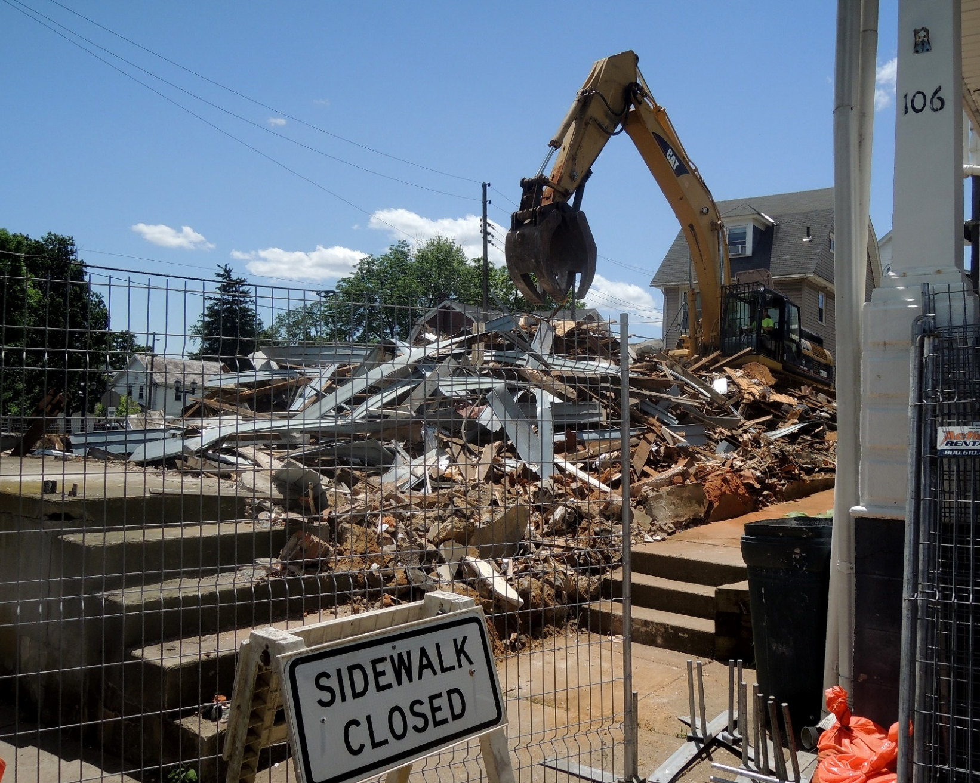
It is possible for a Conservation District to regulate not much more than demolition.
It is means for the preservation of valued historic neighborhoods and our quality of life.

Slide 9
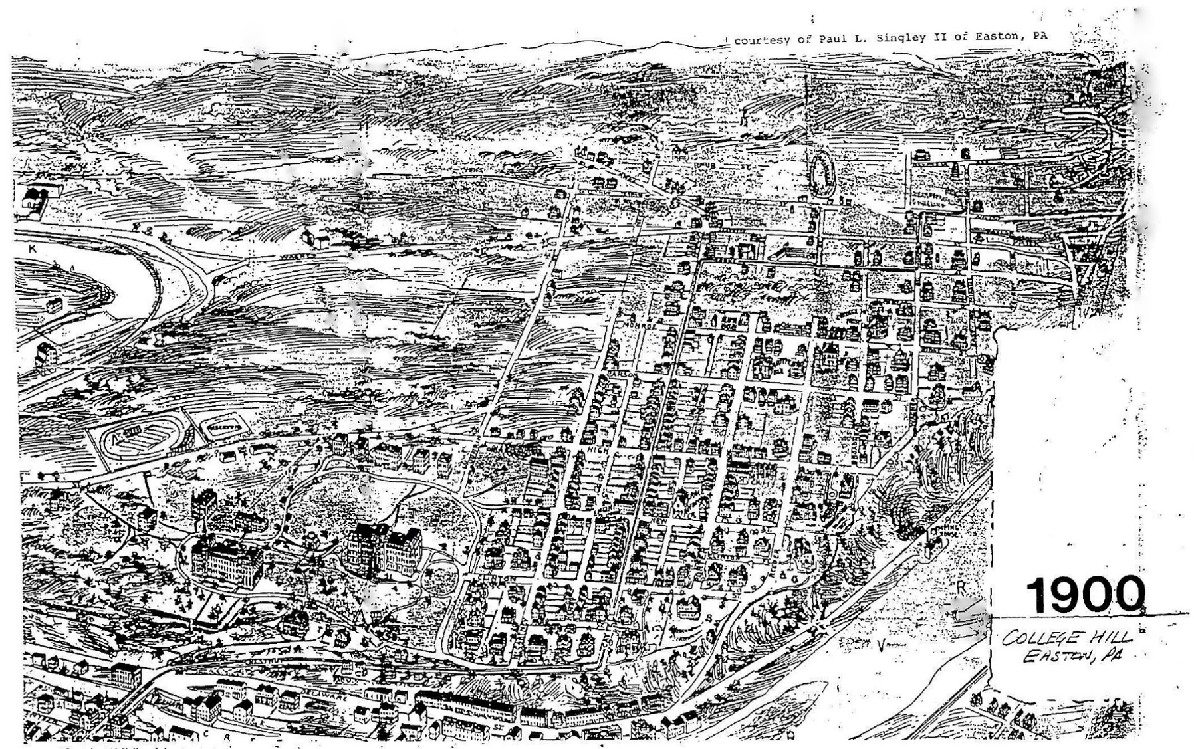
What makes sense for the future of College Hill’s distinctive and historic character?
Let’s talk about how a Conservation District might provide a tool to protect what we value.

Slide 10
“The strength of a nation is derived from the integrity of its homes.”
Confucius
Discussion to be continued. . .

